Slide 1
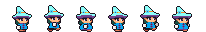
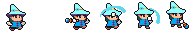
Merlin the Meek
Final Presentation

Slide 2
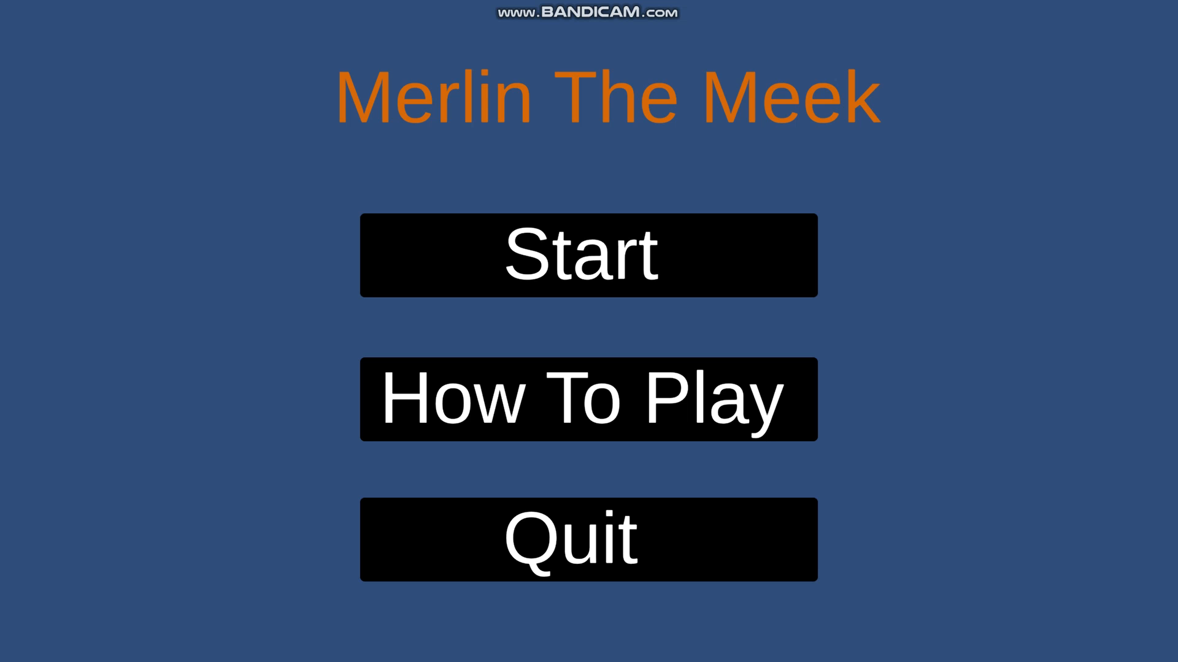
Demo video

Slide 3
Project Achievements
The character of Merlin was entirely original, and his design and animations were created during the project without any prior knowledge on the subject.
Likewise, the story of the game was original, and a storyboard was drawn up early in the project. Though it didn't make its way into the game it was played a large part in the inspiration for the project throughout development.
Overcoming difficulties like projectile spawning, satisfying movement and getting the finish line working were also big achievements throughout the project.

Slide 4
Project Difficulties
Covid caused working as a group to be done entirely through the internet. This changed the way we had to work on the project and made communication and small tweaks very difficult and time consuming.
Around halfway through the project we had a major problem with communication. Two of the team members went silent and during this time only a small amount of work got done on the project. This pushed us far behind in our schedule and left us without things like art assets that we were waiting on.
Early in the module we were left with a lack of direction. Without prior knowledge that we were going to be making a game we were left desperately scurrying for an idea on what to make.

Slide 5
Reflections
Prior to the communications breakdown as well as after we worked well as a group. Regular meetings together meant that we were often able to voice concerns or difficulties that someone required assistance on.
More of said meetings would've probably improved the project as well as creating more documents to keep everyone's visions on the project along the same tracks.

Slide 6
Questions?
We would now like to give space for questions.

